Slide 1

MySQL & MySQL Workbench Tutorial
A presentation on MySQL and using the MySQL Workbench database software tool.
This presentation assumes a basic knowledge of relational databases.
Robert Freeman
SFSU Undergraduate Computer Science Student
4/14/2021
Copyright: Robert Freeman ©

Slide 2
Objectives
Define MySQL and MySQL Workbench
Install MySQL Workbench
Learn how to create tables with two different methods
Create tables in the live database
If this method is chosen, Forward Engineering can be done, but it is more difficult
Create an entire database using the Forward Engineering tool in MySQL Workbench
Good for those who need the entire database in a single model quickly
Perhaps by beginning with forward engineering, it can be a good idea to further create tables using the single-table creation feature. Editing the model and redoing Forward Engineering is highly recommended.

Slide 3
Definitions
MySQL: an open-source relational database management system with a client-server model. This system allows users to store, manage and manipulate data.
MySQL Workbench: a tool to access MySQL. It has a nice GUI for making tables, creating foreign keys, and making simple tables quickly.
Copyright: Robert Freeman ©

Slide 4
MySQL
MySQL functionalities:
Creating tables individually
Creating tables using the MySQL Workbench Forward Engineering tool
Creating database tables which can relate to one another using foreign keys to emulate use cases and business requirements via cardinalities (not covered in this presentation).
Copyright: Robert Freeman ©

Slide 5
MySQL Resources
Tutorials on MySQL using MySQL Workbench
1-hour video:
https://www.youtube.com/watch?v=9ylj9NR0Lcg
11-minute video:
https://www.youtube.com/watch?v=2bW3HuaAUcY
I did not create, nor do I own these videos.
Copyright: Robert Freeman ©

Slide 6
MySQL Documentation
MySQL Documentation
https://dev.mysql.com/doc/
MySQL Workbench Documentation
https://dev.mysql.com/doc/workbench/en/
Copyright: Robert Freeman ©

Slide 7
How to install/setup MySQL Workbench
Download for macOS (recommended):
https://dev.mysql.com/doc/mysql-osx-excerpt/5.7/en/osx-installation-pkg.html
Download for Windows:
https://dev.mysql.com/doc/workbench/en/wb-installing-windows.html
Copyright: Robert Freeman ©

Slide 8
Installing MySQL Workbench on macOS
Click on MySQL Community Server
Select macOS
Download your macOS DMG file (you don’t need to register).
Download, run and install
System Preferences -> MySQL
Click Start MySQL Server
Copyright: Robert Freeman ©

Slide 9
Installing MySQL Workbench on macOS
Click MySQL Workbench
Select macOS
Download your macOS DMG file.
Once the DMG file is finished downloading, run it and install it.
Drag the app icon into the application folder.
Open MySQL Workbench
Copyright: Robert Freeman ©

Slide 10
Installing MySQL Workbench on Windows
Download for Windows:
https://dev.mysql.com/doc/workbench/en/wb-installing-windows.html
This link is a great resource for installing. Follow the guide here.
Download the DMG file, run it and choose Develop Default.
Choose Standalone MySQL Server / Classic MySQL Replication (default). Continue with the link above for more on installation process.
Copyright: Robert Freeman ©

Slide 11
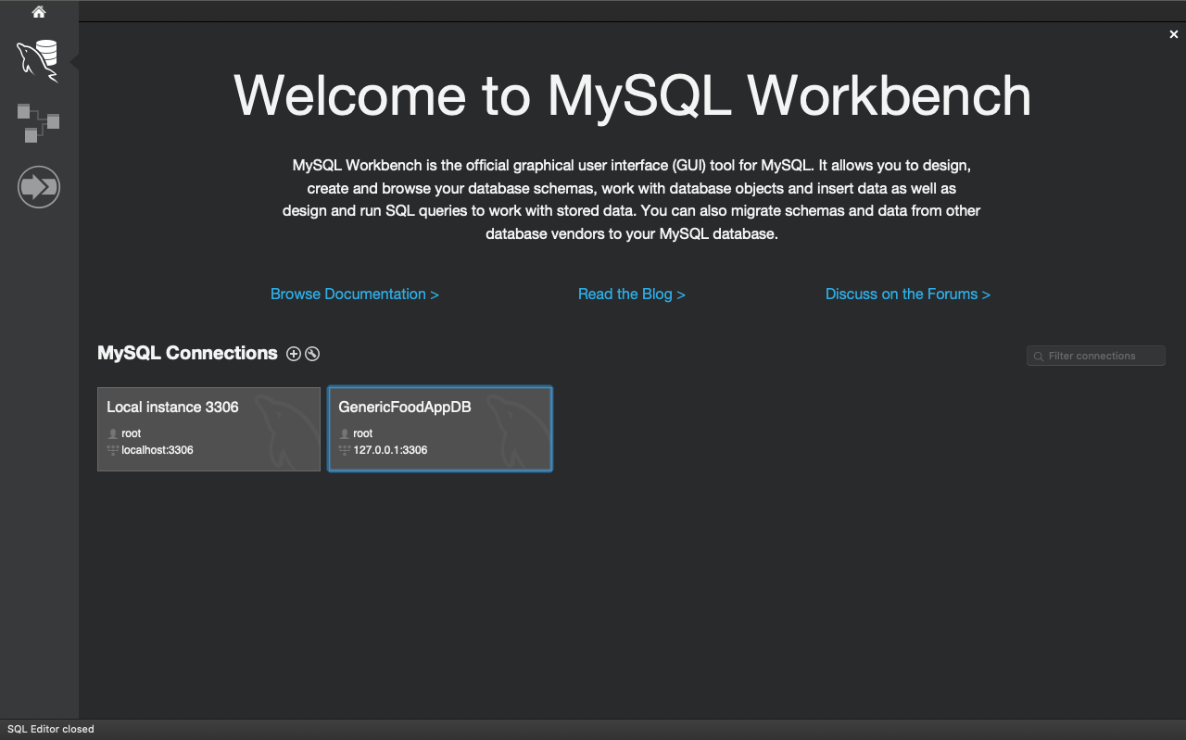
Add a new instance
Copyright: Robert Freeman ©

Slide 12
Create a password
It is important not to forget this password. It can be difficult to reset.
The username is ‘root’ by default.
localhost:3306
Choose Configure Server Management…
Copyright: Robert Freeman ©

Slide 13
Two Methods for creating tables
1. Creating tables one at a time using MySQL Workbench
2. Forward engineering the entire database using MySQL Workbench
Please note that all database table creation will be done using the MySQL Workbench software tool.
Copyright: Robert Freeman ©

Slide 14
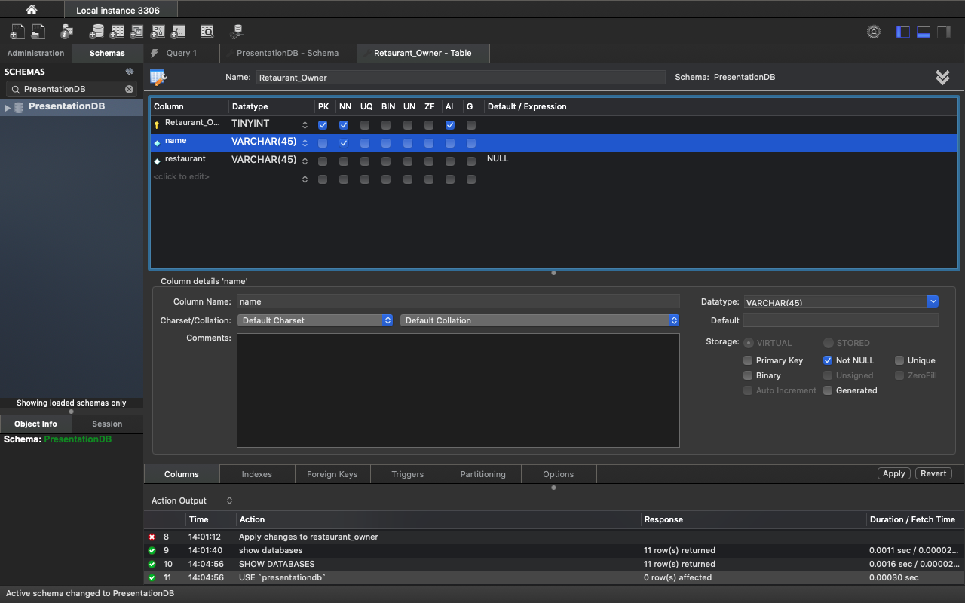
Creating tables one at a time
Process in general:
Click create table in the top left corner, see purple circle→
Add the table’s primary key: use consistent naming such as Restaurant_Owner_id
Make sure the primary key has options set: Primary Key (PK), Not Null (NN), and autoincrement (AI).
Change datatype of Primary Key to TINYINT to save on storage
Add columns and change datatypes and options as needed
Press apply
Copyright: Robert Freeman ©

Slide 15
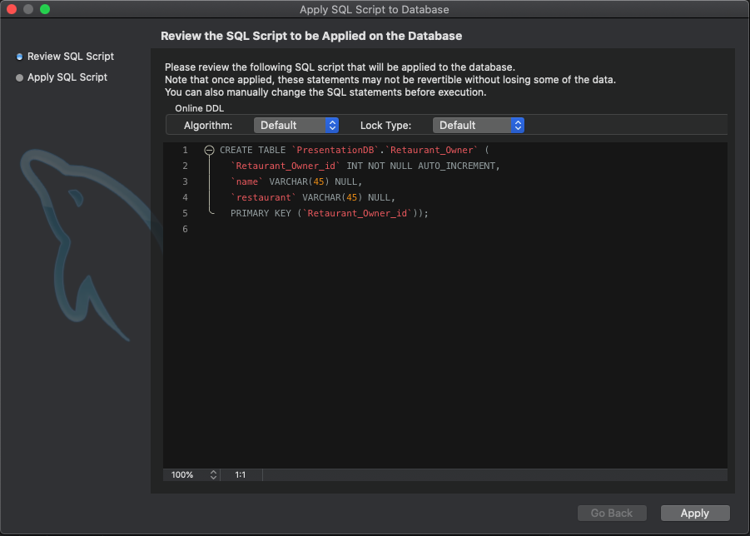
Copy the script
Copy the script by simply highlighting the code and right click to copy.
We will use this later
If everything looks good, hit apply again.
Copyright: Robert Freeman ©

Slide 16
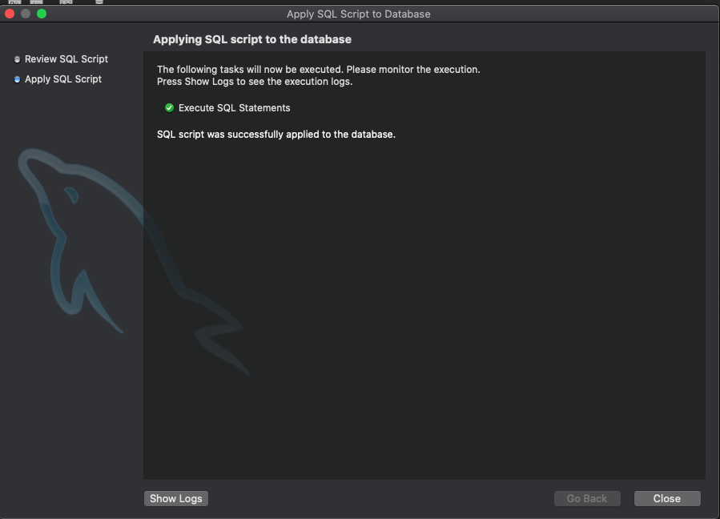
Verify success
You should see this screen, hit ‘close’.
If you get an error, check the table again to make sure there are no bugs, and retry.
Copyright: Robert Freeman ©

Slide 17
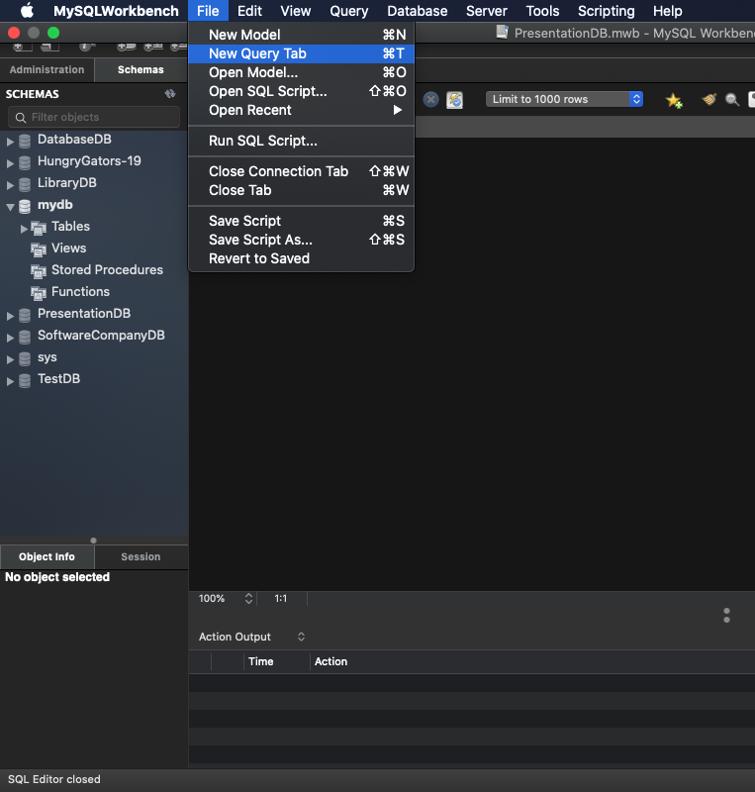
Open a new query tab
Create a new query tab by navigating to your instance and selecting
File > New Query Tab
This will allow us to paste in our script and use the table as we please.
Copyright: Robert Freeman ©

Slide 18
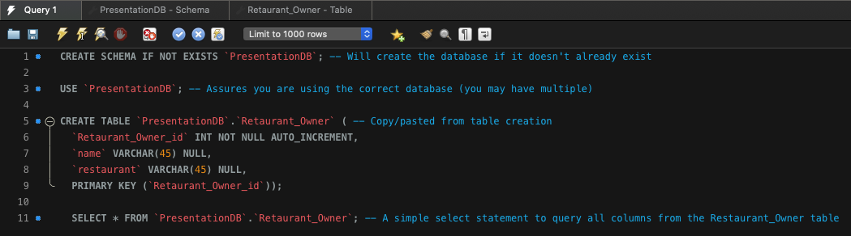
Selecting from a table
By adding lines 1, 3, and 11 in addition to pasting our table, we can successfully create a database and query our table we’ve just created.
Run the query by pressing the lightning bolt, and the database is running on your local instance (check for errors in the action output).
This script can be pasted into the mysql> shell to put this database onto the cloud.
Copyright: Robert Freeman ©

Slide 19
Forward Engineering in MySQL Workbench
Forward Engineering –
A tool for schema creation in MySQL Workbench:
Enables you to easily create a script of your database model using the MySQL Workbench GUI. Errors are still possible, and initial debugging of the schema should happen in the GUI rather than the code itself.
You can
Export a script
Alter an existing database
Create a new database
(This tutorial will focus on creating a new database)
More on Forward Engineering
Copyright: Robert Freeman ©

Slide 20
Workflow for Forward Engineering in MySQL Workbench
Recommended workflow
Create tables and foreign keys in the GUI.
If the Forward Engineering process fails, find the errors in the MySQL Workbench GUI (perhaps a primary key is not set to NN or PK).
Repeat the forward engineering process again until all green dots are shown at the end (more on this later).
Note that issues may still occur if/when FE process passes with all green dots if proper Entity Relationship practice is not followed.
More on Forward Engineering
Copyright: Robert Freeman ©

Slide 21
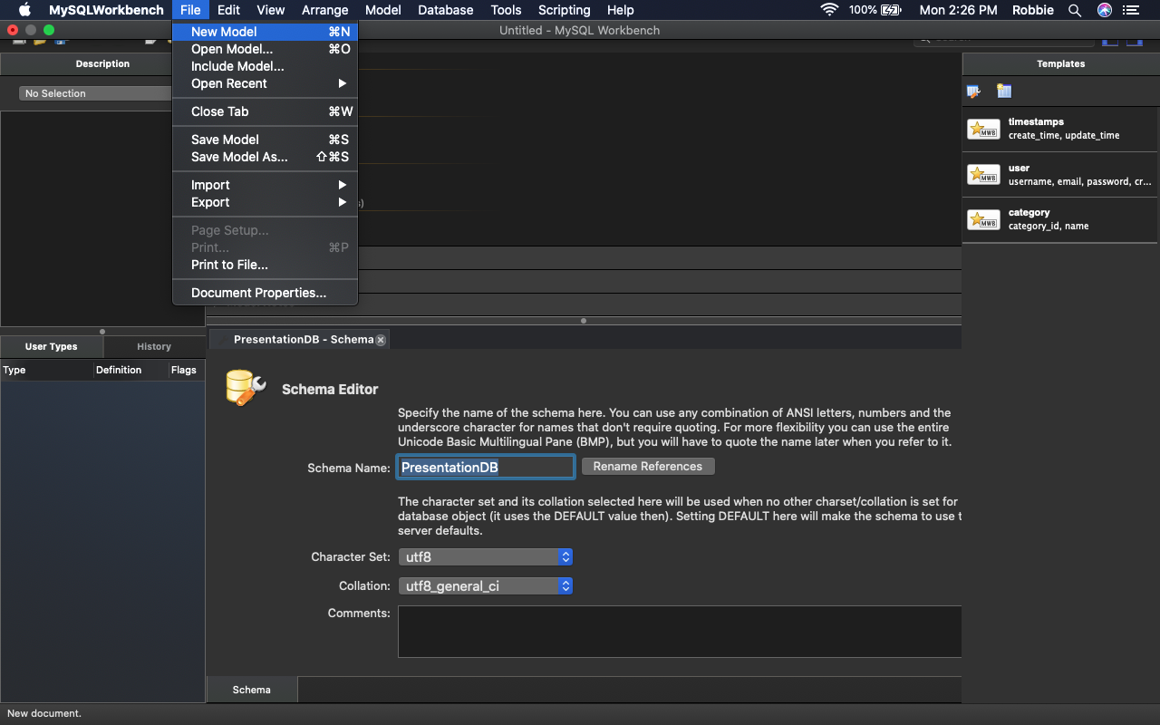
Forward Engineering : Creating a model
Create a new model
File > New Model
Or command N on macOS
Name your DB in the Schema Editor
Copyright: Robert Freeman ©

Slide 22
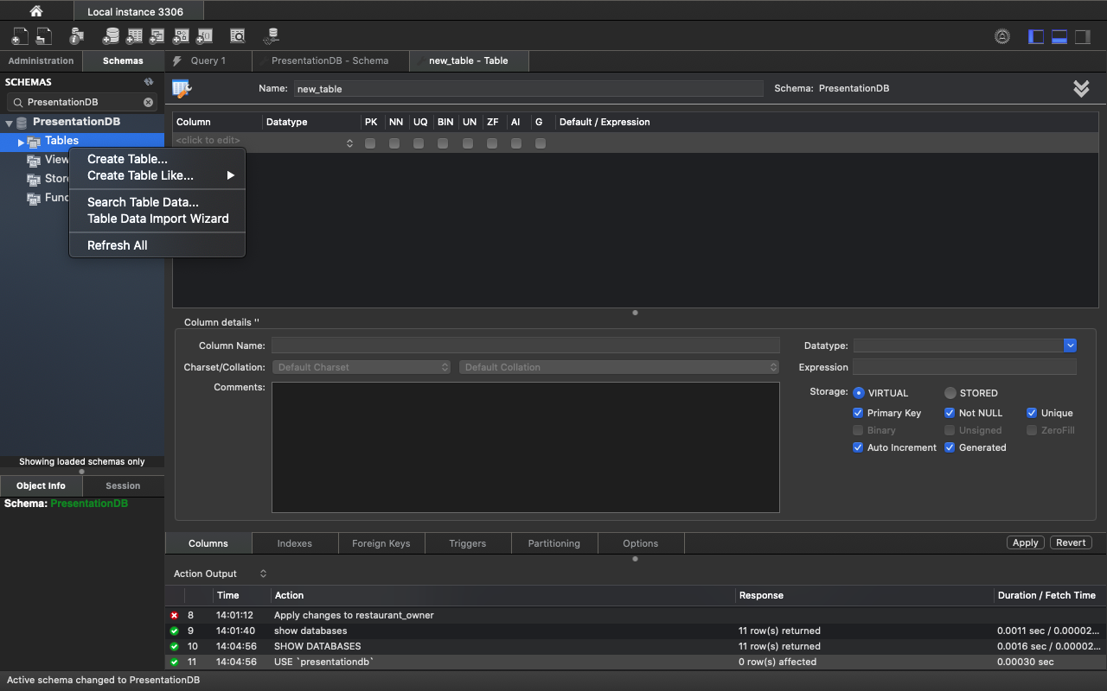
Forward Engineering: Table creation
Create a new table
Tables > Create Table…
Copyright: Robert Freeman ©

Slide 23
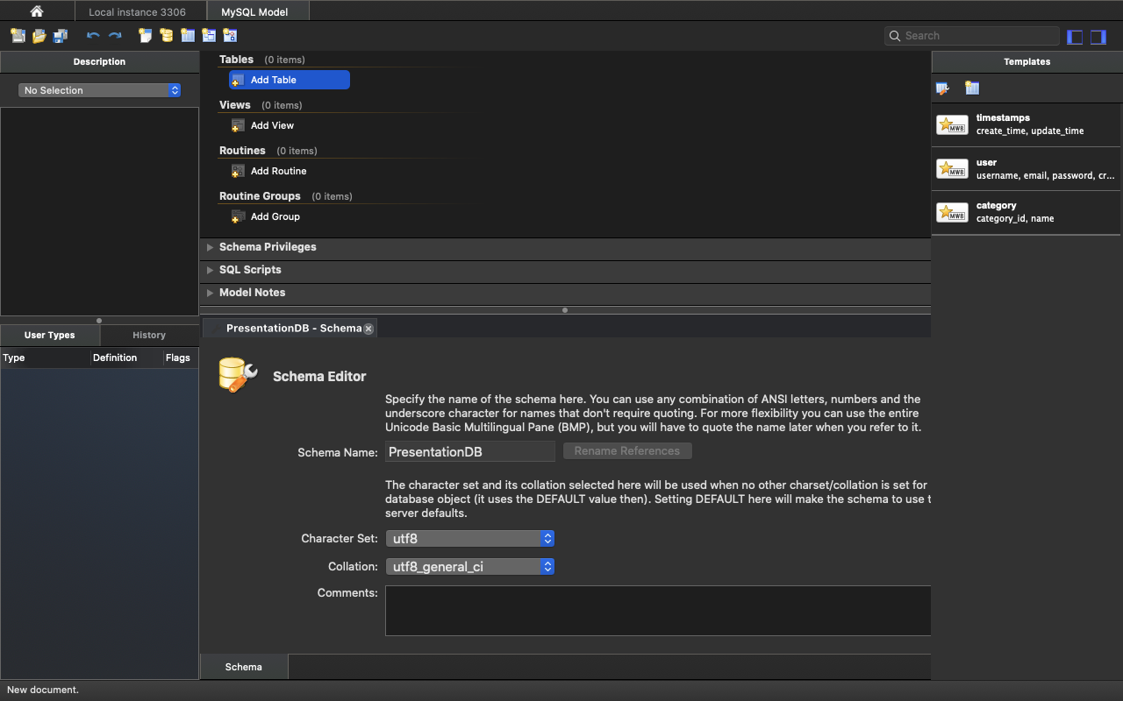
Forward Engineering: Another way to add tables
MySQL Model > Add Table
Copyright: Robert Freeman ©

Slide 24
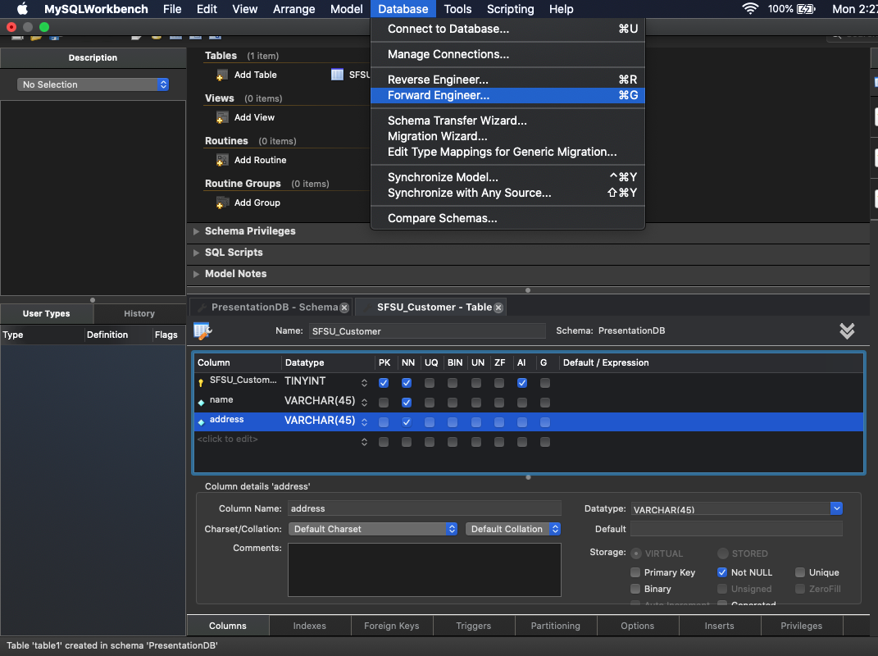
A similar process for creating tables
Process in general:
Add the table’s primary key: use consistent naming such as SFSU_Customer_id
Make sure the primary key has options set: Primary Key(PK), Not Null (NN), and autoincrement (AI).
Change datatype of PK to TINYINT to save on storage
Add columns and change datatypes and options as needed
Database > Forward Engineer…
Copyright: Robert Freeman ©

Slide 25
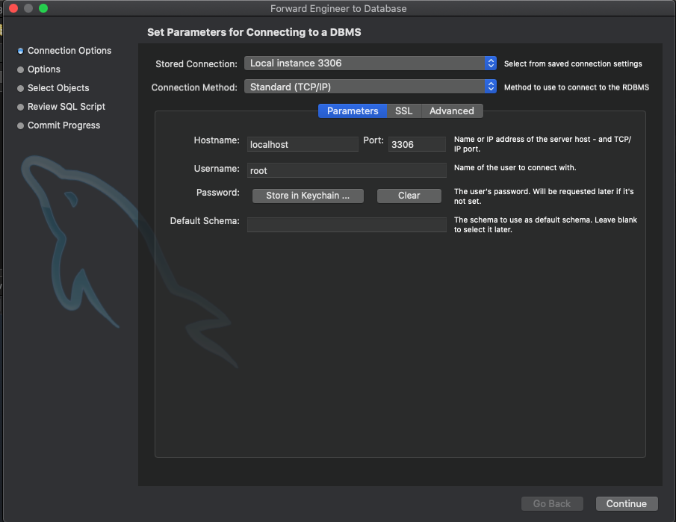
Hit Continue
For the purposes of this class, these options aren’t important.
Continue
More on Forward Engineering
Copyright: Robert Freeman ©

Slide 26
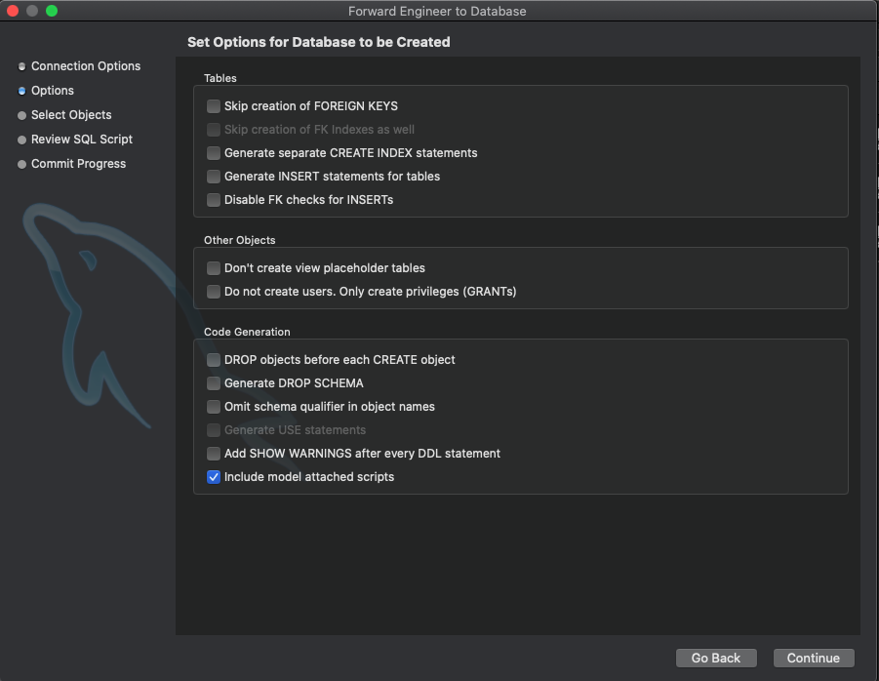
Hit Continue Again
For the purposes of this class, these options aren’t important.
Continue
More on Forward Engineering
Copyright: Robert Freeman ©

Slide 27
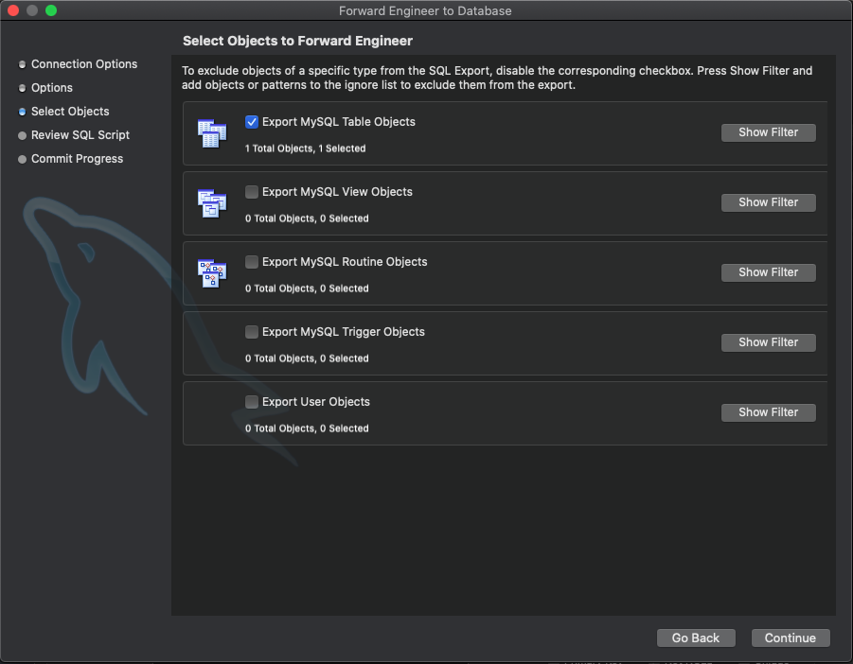
Continue
For the purposes of this class, these options aren’t important.
Continue
More on Forward Engineering
Copyright: Robert Freeman ©

Slide 28
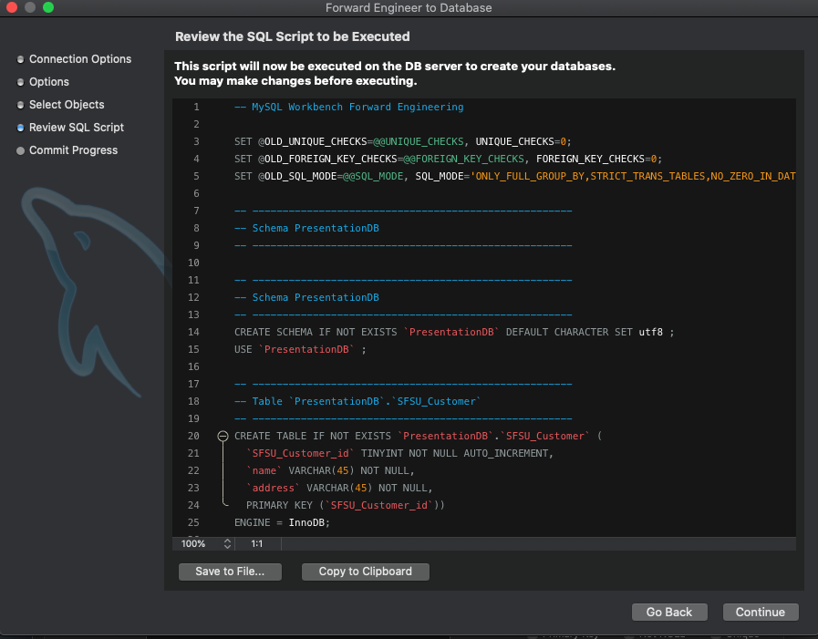
Forward Engineering: A database ready to run
Copy to Clipboard
Continue
Check the next screen for errors, you may have some and the script will not be ready to run.
Just like magic, your database is complete
Copyright: Robert Freeman ©

Slide 29
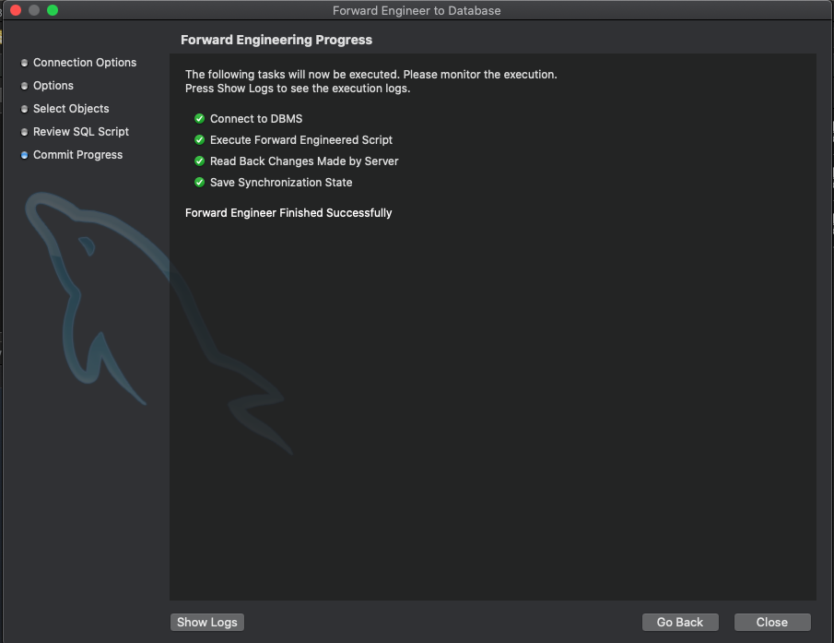
Forward Engineering: Progress
Green dots?
You’re set
Red dots?
Return to table creation and see what could be wrong, fix it, and return to the forward engineering process. This is the basic workflow.
It is strongly recommended that you do not attempt to fix the MySQL code line-by-line.
Copyright: Robert Freeman ©

Slide 30
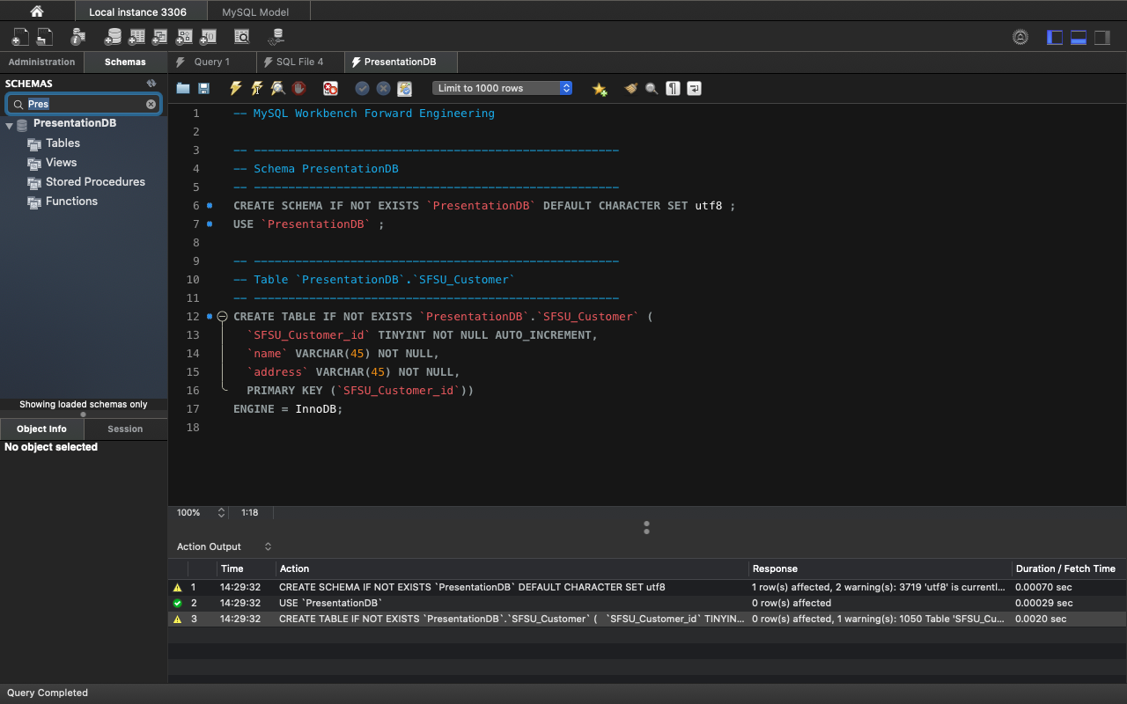
Paste in the copied code from Forward Engineering into a new query tab, press the left lightning bolt, your database is now running on your local instance.
Repository
https://github.com/RobertAldenFreeman/mysql-presentation-repository.git
Checkout to master
Copyright: Robert Freeman ©

Slide 31
Questions
Please feel free to ask any questions about MySQL or MySQL Workbench
10-minutes

Slide 32
References
1-hour MySQL video:
https://www.youtube.com/watch?v=9ylj9NR0Lcg
11-minute MySQL video:
https://www.youtube.com/watch?v=2bW3HuaAUcY
MySQL Workbench Documentation
https://dev.mysql.com/doc/
https://dev.mysql.com/doc/workbench/en/
Download MySQL Workbench for macOS (recommended to use macOS if possible):
https://dev.mysql.com/doc/mysql-osx-excerpt/5.7/en/osx-installation-pkg.html
Download MySQL Workbench for Windows:
https://dev.mysql.com/doc/workbench/en/wb-installing-windows.html

Slide 33
Ask me for help
Please feel free to reach out to me for high-level questions about MySQL Workbench, I would be happy to help.
For further information on creating relational databases using MySQL Workbench and foreign keys, see
https://dev.mysql.com/doc/workbench/en/wb-table-editor-foreign-keys-tab.html
You can reach out to me by email:
robertfreeman6092@gmail.com

Slide 34
Thank you!

